Slide 1



Northeastern Illinois
Roundabout Case Study
Paul LaFleur, PE
Project Manager, Kane County Div. of Transportation
Matt Papirnik, PE, PTOE
Phase I Project Manager, Burns & McDonnell
Jason Salley, PE
Geometric Studies Unit Head, IDOT District 1

Slide 2
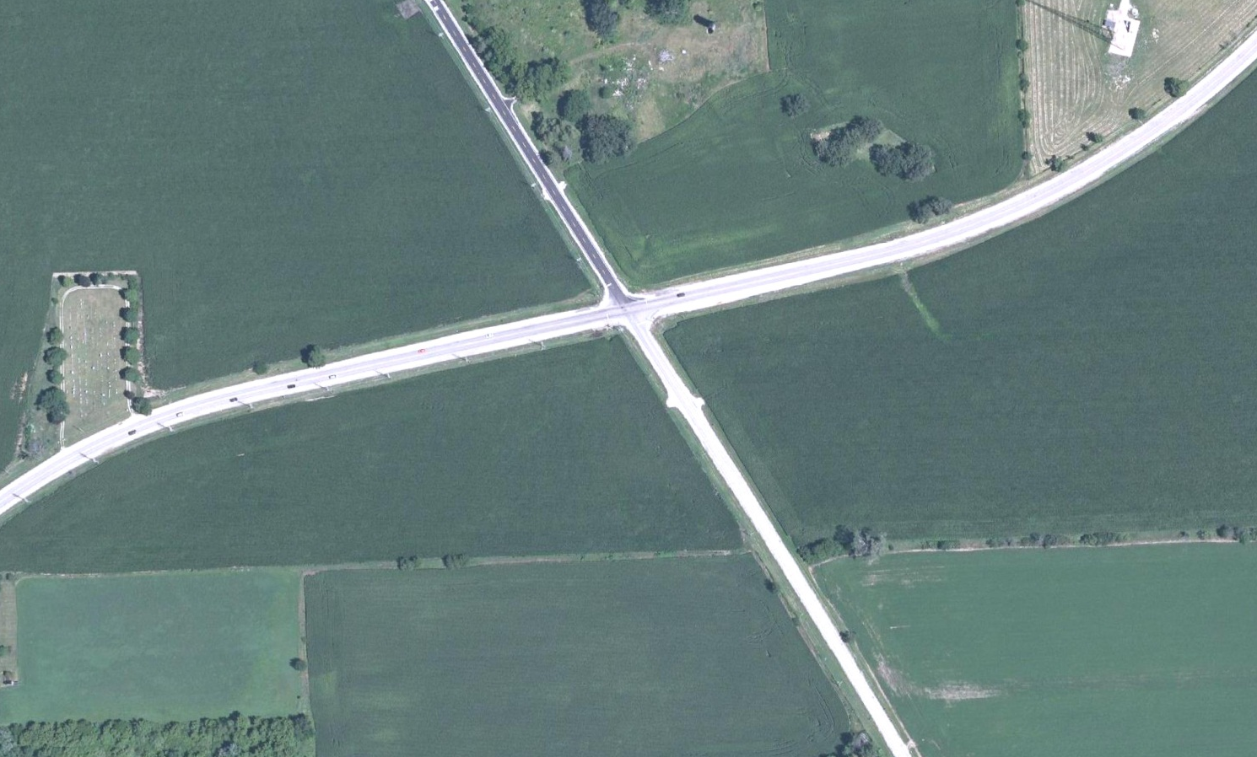
Existing Conditions/History
Notes:
Clear the Slide! Stop Swaying!
Here you will see an aerial image of the project location. It is surrounded by agricultural fields on all corners. It is a very flat area. There are only 6’ of fall over the entire project limits. IL 47 runs in a general north-south direction, though it curves through this intersection and runs northeast and southwest. IL 47 has 2 large radii curves near the project limits. Burlington generally runs as you see it here in a northwest-southeast direction.
Describe the area, the terrain, adjacent land uses, the profile. Make sure to point out curves on IL 47

Slide 3
Intersection Evolution
Originally a Two-Way Stop Control
  Functioned fine for a rural intersection
Four-Way Stop Controlled Intersection
  Made intersection significantly safer
  Added advance signing and flashing beacon
Notes:
Clear the Slide! Stop Swaying!
This intersection has evlolved slightly over the years. Up until the early 2000s it was a 2-way stop controlled intersection, then after a fatal crash it was made a 4-way stop. This condition significantly increased the safety of the intersection. Itoperated fine, with only minor tweaks (addition of flashing beacon and additional signage), until the urban sprawl caught up with the surrounding area funneling more traffic through the intersection. Capacity became an issue as both roads were seeing higher ADTs. There was an observed delay of 65s in the AM peak hour when the traffic counts were performed in Phase I.

Slide 4
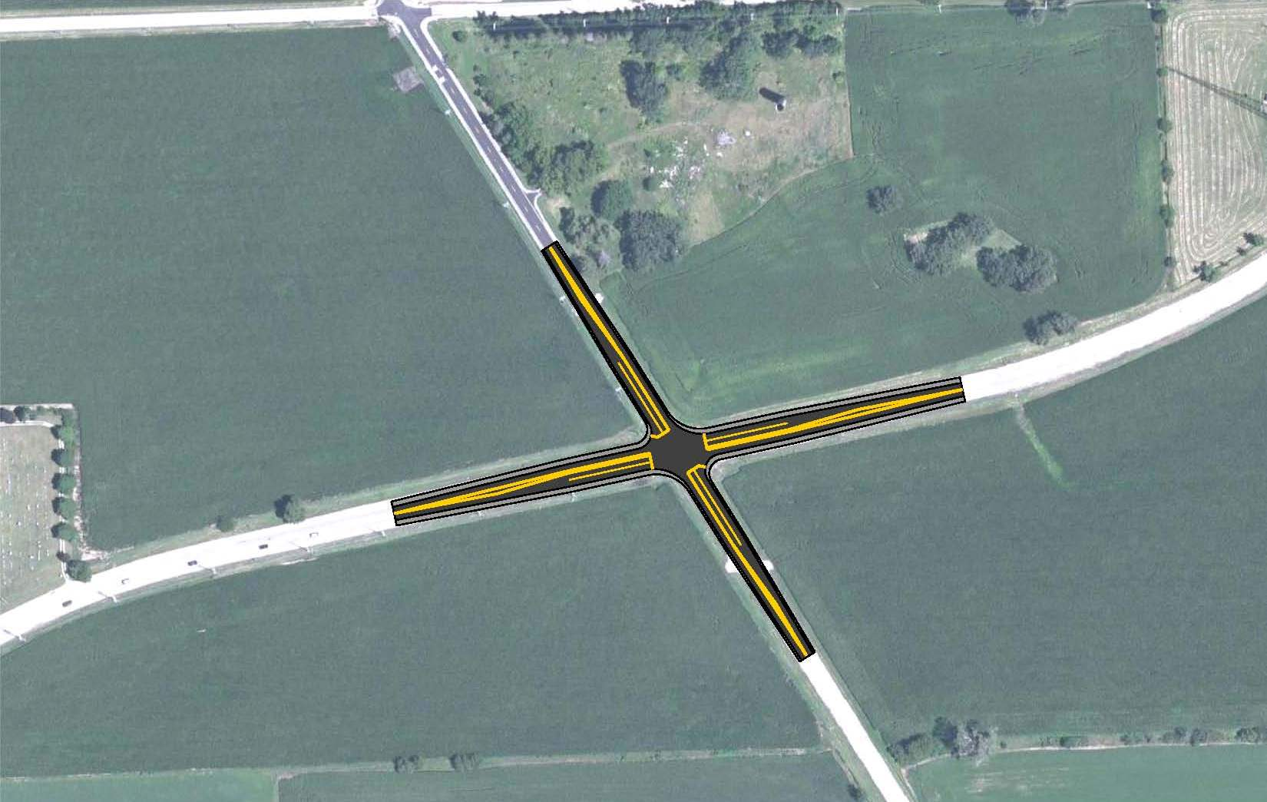
Getting Started: CMAQ Application
Add Left Turn Lanes and Signals
Limited Budget
Notes:
Clear the Slide! Stop Swaying!
This intersection was identified by county staff as an intersection we would like to improve. A CMAQ application was drafted and submitted to add turn lanes and signals. It has a very limited scope budget. CMAQ appliocations are by definition very conceptual and can often not anticipate all problems that will need resolving. In late 2006 we were selected and approved for CMAQ funds and in 2007 we began studying the intersection.

Slide 5
Phase I, Part A
Design Criteria
  3R/Reconstruction guidelines
Scope Creep beyond CMAQ Application
  Additional turn lanes for symmetry
  Superelevation
  Detention
  Additional ROW
Made it to an Approved IDS and LDS
Notes:
Clear the Slide! Stop Swaying!
Upon beginning Phase I we determined the design criteria to be used was 3R, with some reconstruction guidelines for taper and storage lengths. This was primarily because of the curves on IL 47 and the high speed approaches to the intersection.
The scope of work began to slowly increase. Due to LOS issues additional turn lanes beyond the initial concept were needed and to create intersection symmetry. The substandard superelevation on IL 47 was impacted by the long tapers and thus required to be brought into compliance with current guidelines. The additional impervious pavement area triggered detention needs under the County Stormwater Detention ordinance, thus requiring more ROW for the detention and the pavement. This scope creep was caused by inflexibility in the standards and the high speed approaches and curves in IL 47.
This alternative made it all the way to an approved IDS and LDS.

Slide 6
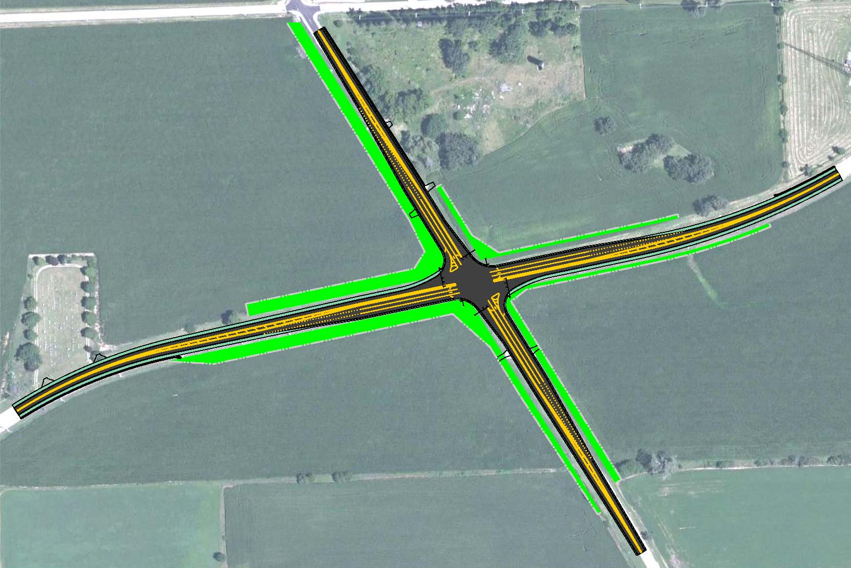
Traffic Signal Concept
Notes:
Clear the Slide! Stop Swaying!
Describe, point out long tapers and symmetrical turn lanes, and larger ROW takes.

Slide 7
Fork in the Road
Hurdles to Overcome
  Larger budget
  Larger scope
  Design exceptions (3) – including 2 for LOS
The Last Straw
  Cut the budget or the project may disappear
Notes:
Clear the Slide! Stop Swaying!
It was after the IDS and LDS were approved and the final PDR being prepared that we took a step back and looked at the project and asked ourselves just what are we doing and compared it to our original intent. We identified several hurdles that we would need to overcome to bring this project to fruition; a larger budget (estimated to be $2.8milliion? Compared to the CMAQ application of $1.Xmillion), larger scope, and 3 design exceptions (2 for LOS and 1 for profile).
I was informed by my bosses that because of all these hurdles this project was in serious consideration to be dropped. I challenged my consultant to find a way to cut the construction cost or this project may go away due to funding. Matt said give me a day to find a way to cut costs. He returned with a roundabout concept.

Slide 8
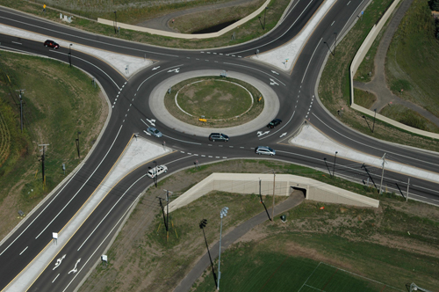
A Roundabout is Born
Notes:
This image is from Washington County, MN, a county sandwiched between St. Paul, MN and the Wisconsin state line.

Slide 9
A Roundabout is Born
Baby Steps Along the Way
  Concept started between the PMs
  Elevated to Senior Staff at the County
  Introduced to IDOT/D1
  Formally brought to FHWA
Phase I, Part B
  Restarted Phase I with RAB as preferred alternative
Notes:
Clear the Slide! Stop Swaying!
We began slowly, taking baby steps along the way with this new concept. We gradually escalated this concept from just Matt and I eventually to the FHWA. At each step along the way we asked each new audience, do you see any fatal flaws in the concept at this location? Are you ready to seriously investigate constructing a RAB on the system? And at each step we were given the thumbs up.
Following this due diligence on our part we set aside the signal concept and began Phase I anew, this time with a RAB as our goal. At this point Matt will take over and tell you how and why a RAB worked better than signals at this intersection.

Slide 10
Why a Roundabout?
Not an Ideal Place for a Signal:
  Long auxiliary lanes for small movements
  Relatively high-volume through movement
  Appropriate design was for two through lane;
  not financially feasible
  Drainage and ROW footprint
  Left turn volume percentage was high
  Design Exceptions for LOS
  No other traffic signal within three miles
Traffic Signal would Restore High-Speed Movement through the Intersection
Notes:
Let’s look a bit closer into the due diligence that led to IDOT and FHWA approval of the shift to a roundabout concept.

Slide 11
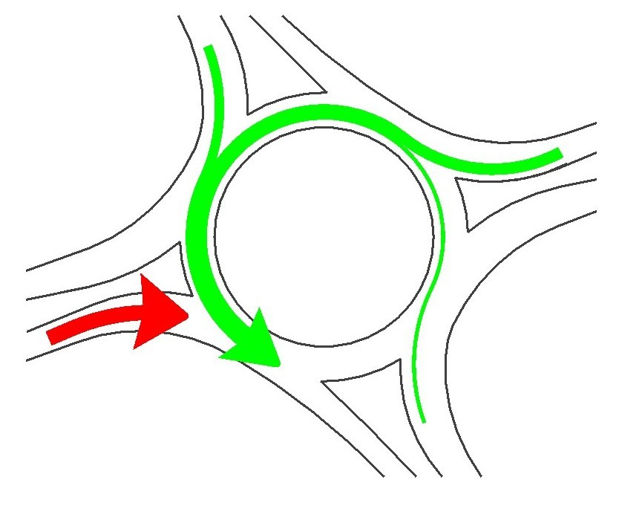
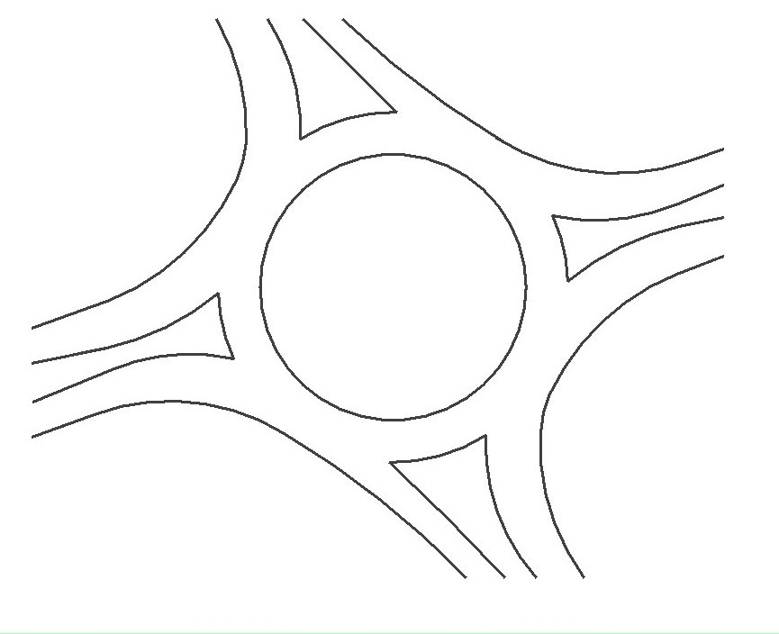
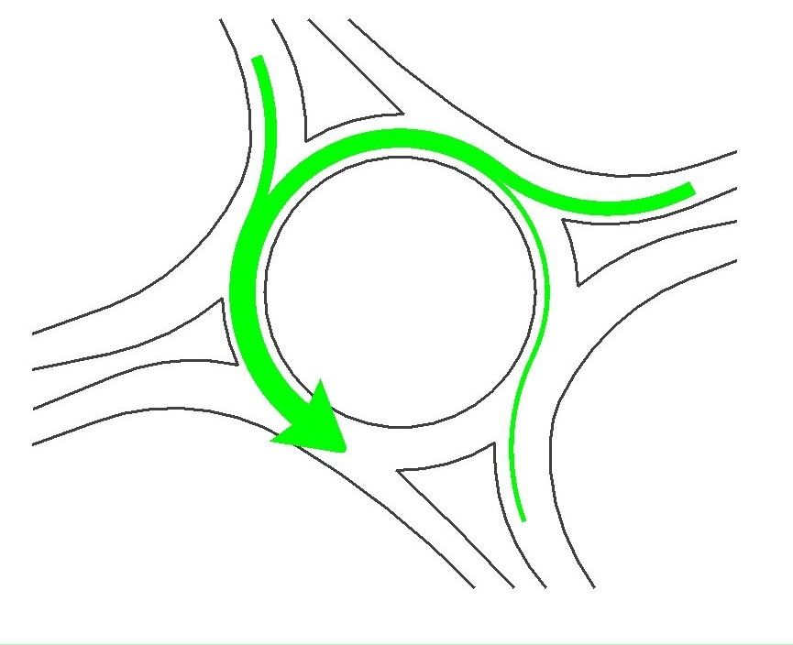
Making the Case for a Roundabout:
Operations
The key to roundabout performance
is circulating volume
Notes:
There are a number of factors controlling roundabout capacity. Perhaps the most important is circulating volume, the fewer and shorter the gaps are between circulating cars. <click> If circulating volumes get too high, the traffic seeking to enter the roundabout doesn’t receive enough gaps to do so, and level of service deteriorates.

Slide 12
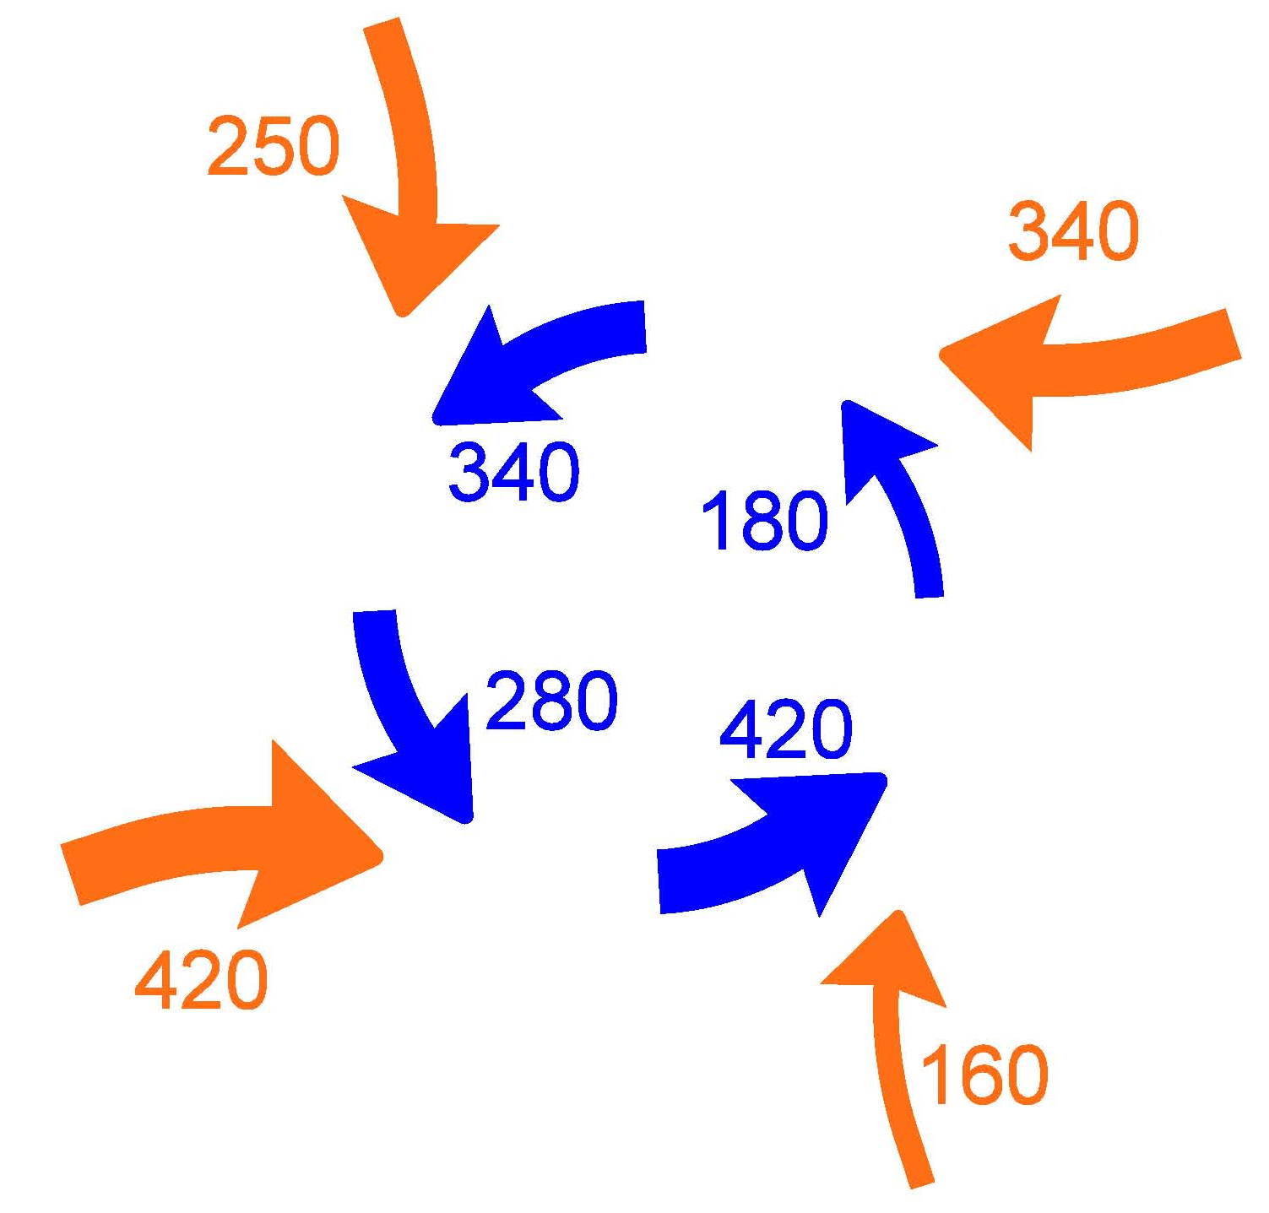
Making the Case for a Roundabout:
Operations
High circulating volumes coincided
with low entering volumes
Notes:
At our site, high circulating flows tended to coincide with lower entry volumes. This meant that entry points with relatively few gaps didn’t need to serve as much entering traffic. In other words, the intersection was well-suited for a single-lane roundabout despite a relatively high intersection volume.

Slide 13
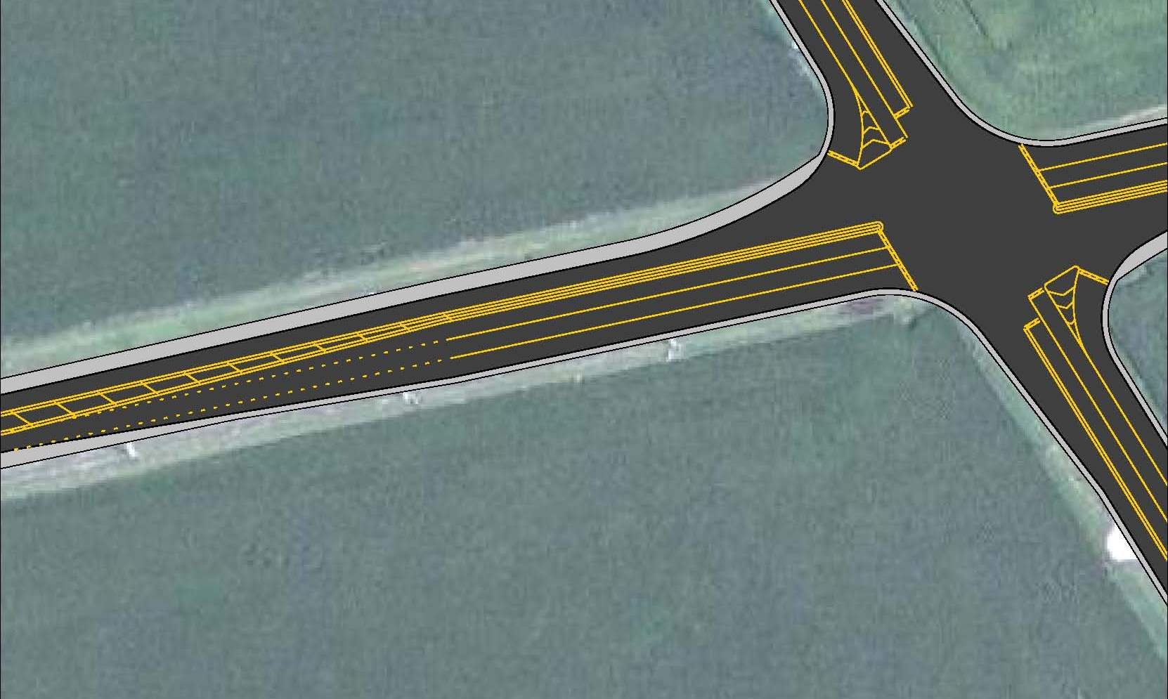
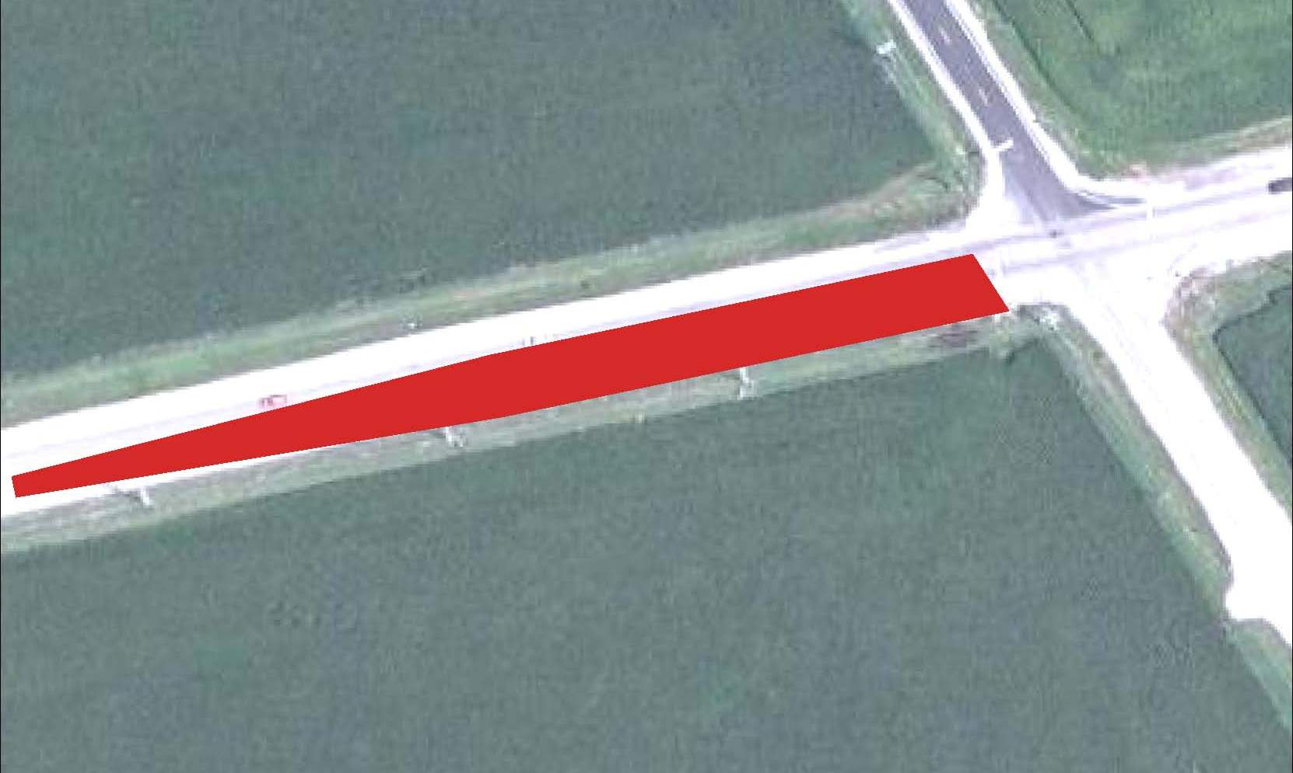
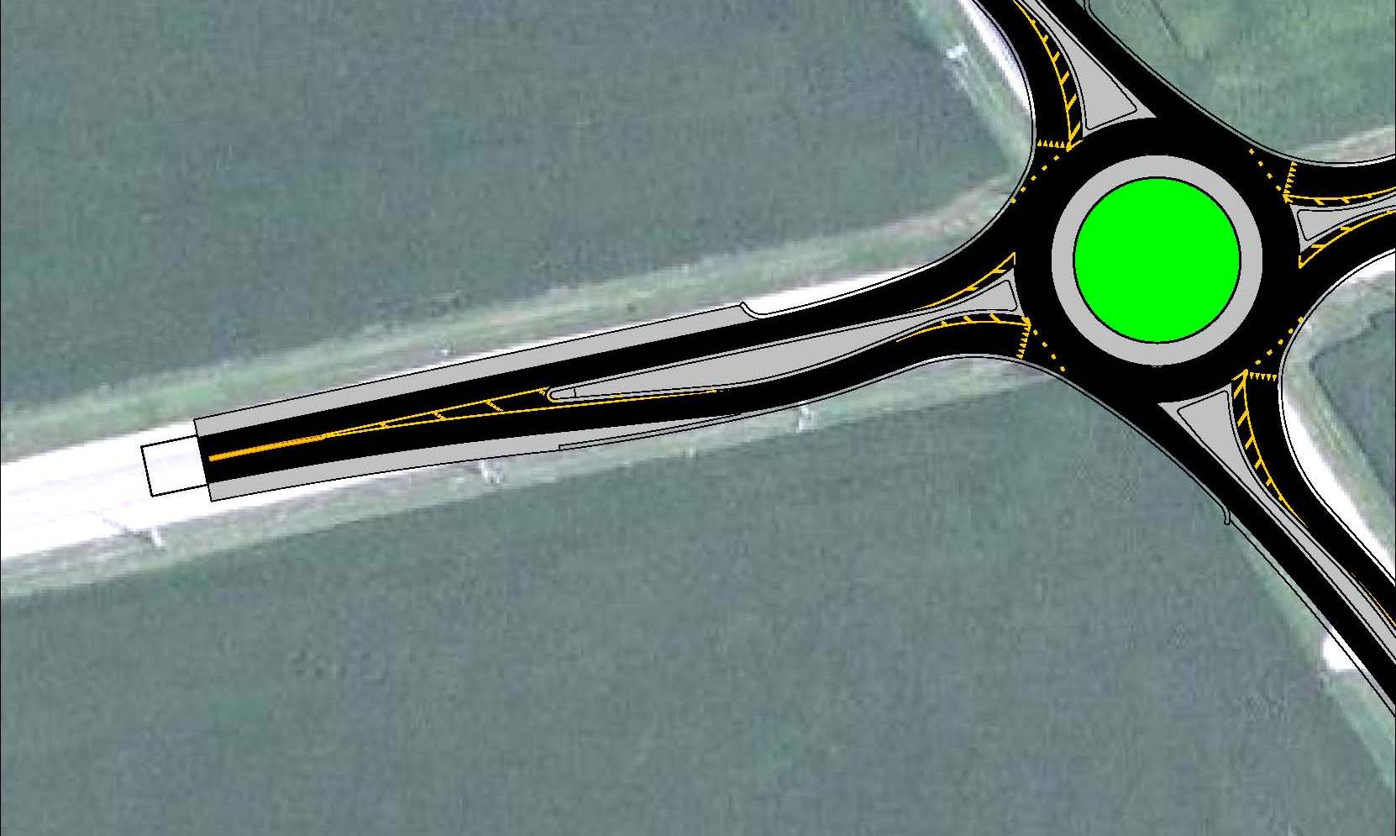
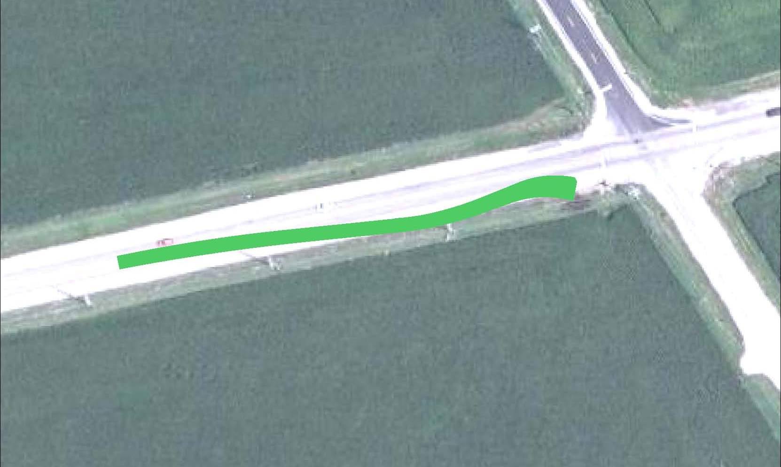
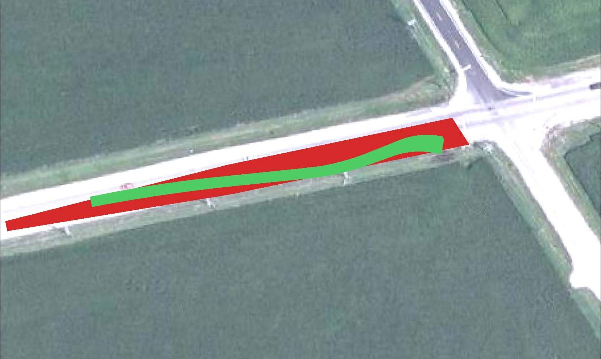
Making the Case for a Roundabout:
Cost
1 Roundabout Approach Lane = 3 Traffic Signal Approach Lanes
Initial concept estimate:
$1.95 million construction
Notes:
One big contribution to the success of the roundabout concept was that it offered the opportunity to save significantly on the cost of new pavement. The northbound Illinois Route 47 approach, which you’re looking at here, is expected to carry approximately 550 vehicles in near-term peak periods. We required three lanes in the traffic signal concept, <click> one for each intersection movement. This created a very large pavement shape. <pause, click> As we talk about the roundabout approach, I want to take a moment to explain the approach geometry. A key to roundabout safety is deflection, which is a measure of how effective your design is in reducing the speed of approaching vehicles. This three-curve design gradually reduces the speed at which a vehicle can travel on approach to the roundabout. Notably, <click> even with the expansive weaving design, the pavement itself only takes up this much space. We knew relatively quickly that<click> a significant cost savings over a traffic signal design was possible.

Slide 14
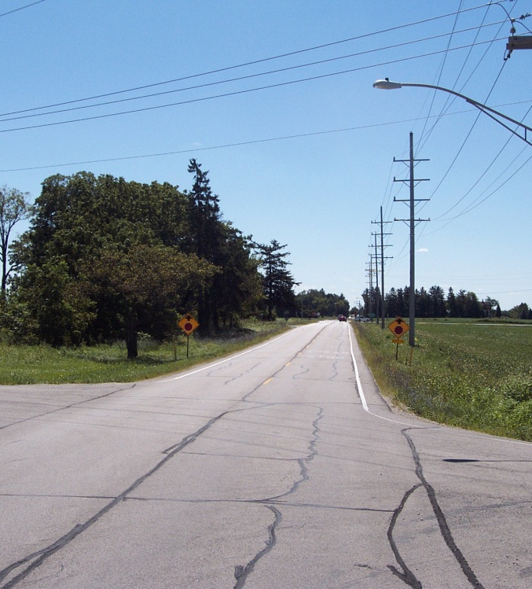
Making The Case For a Roundabout:
Other Factors
Good Approach Visibility
Existing Four-Way Stop
Very Low Crash Rates
This told us two things:
No existing issues in slowing from high rural speeds
Approaches didn’t need dramatic deflection to be effective and safe
Notes:
“very low crash rates” since a four-way stop was installed!

Slide 15
Comparing Performance
Initial SIDRA Analysis
  LOS A on Opening Day (vs. low C for signal)
  LOS E in 2030 (vs. high C for signal)
Determine the Point of Breakdown
  Year 2015, 2020, 2025 traffic interpolated
  Compare signal and roundabout performance
  Estimate improvement breakdown
Roundabout Concept Outperformed Traffic Signal for Most of the Study Period
Opportunity for Expandability
Notes:
Once IDOT had bought into the change in scope, we began the detailed Phase I analysis of the roundabout.
SIDRA is roundabout analysis software currently preferred by IDOT over HCS or Rodel.

Slide 16
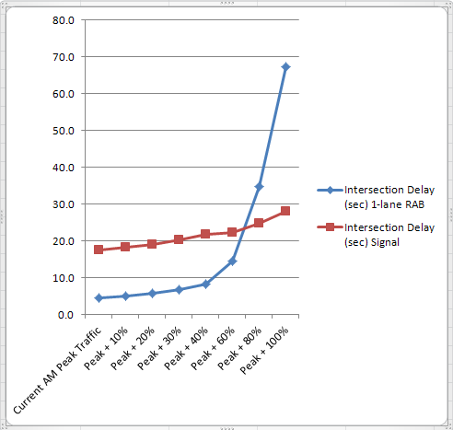

Comparing Performance
A two-lane roundabout provided an excellent long-term solution

Slide 17
Meeting Current and Future Needs
Designing for 2013?
Designing for 2030?
12,000 VPD
Driver unfamiliarity
Emerging policy
Maintaining budget and schedule
25,000 VPD
Unpredictable changes in travel patterns
Area development
Unknown scope of widening for adjacent sections
A phased-construction approach, consisting of a
single-lane roundabout in 2013, was approved in the
May 2010 IDOT/FHWA coordination meeting
Notes:
Remember this is a CMAQ project.
Breathe after going through 2013.
2030: Traffic is anticipated to double. The proportion of turning movements was relatively unpredictable because the “frontier” of County development stops just short of the intersection. For that matter, a gas station or fast food restaurant on the corner could completely change the turning movement patterns in the intersection itself.

Slide 18
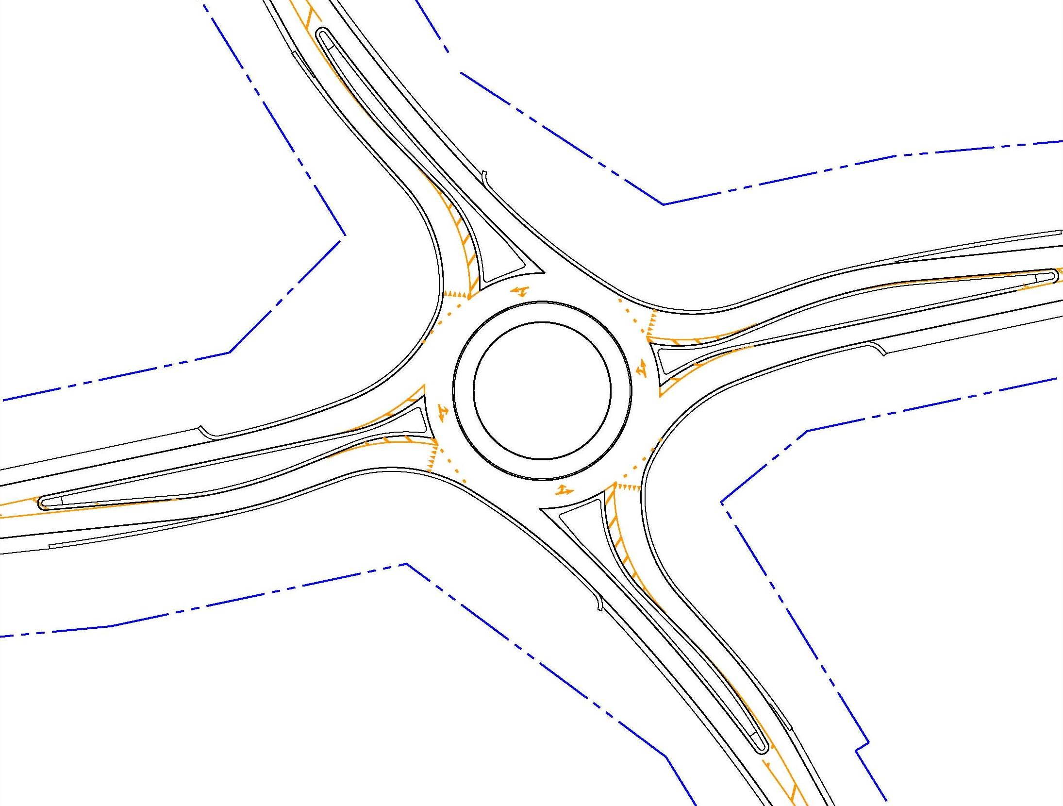
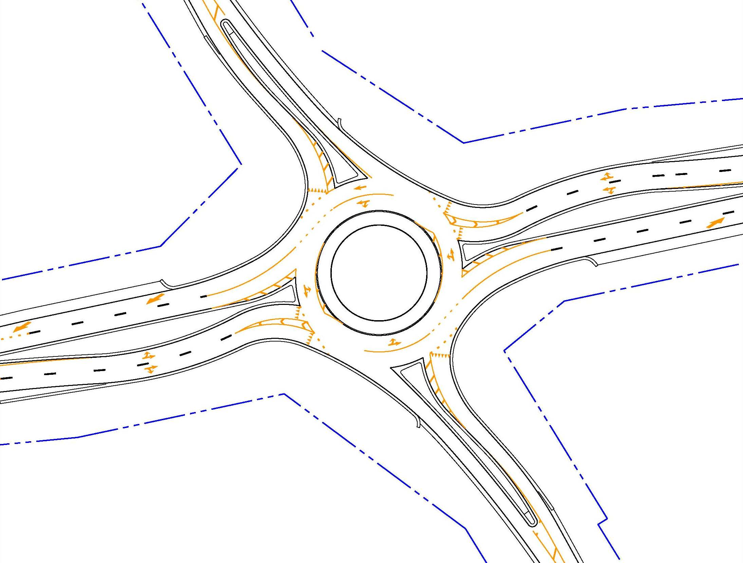
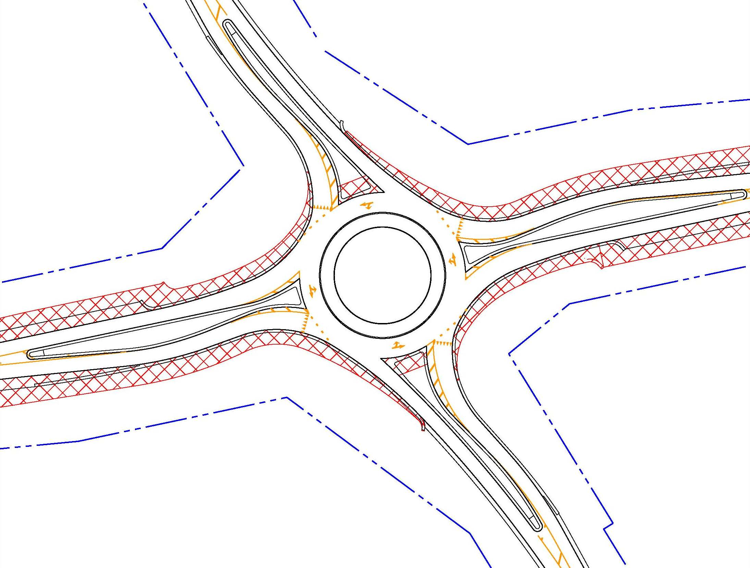
Phase I design was developed with expandability in mind
Notes:
In order to justify the phased-improvement approach, we secured the 2030 ROW.

Slide 19
Adapting the Concept
Coordination and Cooperation
Designing with a Constant Eye on Budget
  Flexibility of roundabout concept became clear
  Retaining the 70-degree angle of intersection
  Limited reconstruction of approaches
Traffic Concerns
  150-foot ICD: expected use by large vehicles, anticipated expansion to two-lane rural roundabout
Expandability Concerns
  Proposed 2030 ROW in single-lane design
Great Expectations
First Priority: Meeting Client Needs
Notes:
“No offense, Jason, but the client came first here.”
“It was IDOT’s first roundabout. The fact that it was on an SRA only intensified their interest in getting it right.”
Mention entry overlap in my talk.

Slide 20
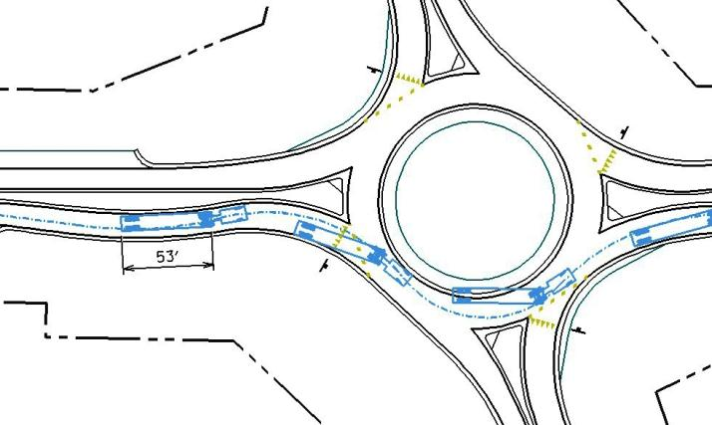
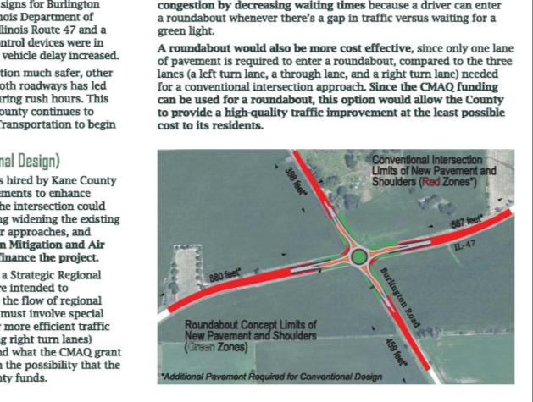
Completing the Process
Public Outreach – Fall 2010
  Public Presentation (30 attendees)
  Midwest Truckers Association, November 2010

Slide 21

Notes:
The video was an effective means of showing attendees how a roundabout at this intersection would work under normal traffic conditions.

Slide 22
Completing the Process
Peer Review – November 2010
County policy requires a review for a
designer with five or fewer roundabouts
Two reviews conducted
  Consultant hired by Kane County
  (included analysis using RODEL)
  IDOT / FHWA
Lessons Learned

Slide 23
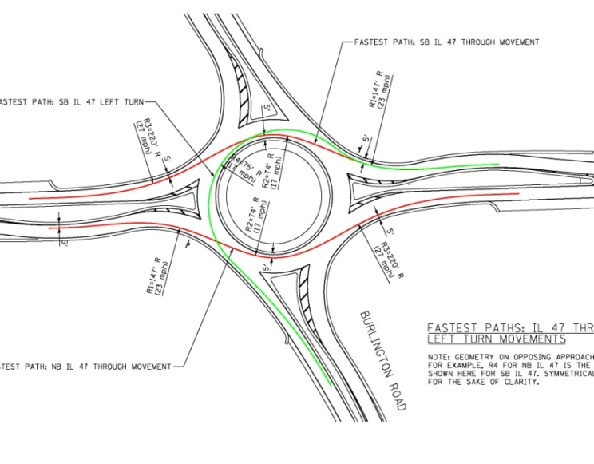
Design Approval
Intersection Design Study (approved April 2011)
Seven Base Drawings
  Standard “front sheet” with statistical analysis
  Detail view of circulating roadway
  Alignments (mainline, approaches and departures, circle – 11 total)
  Profiles
  Fast paths
  Truck turning movements
  Typical sections and details
Two sets of drawings
  One for single-lane improvement
  One for two-lane improvement
Location Drainage Study (approved June 2011)
Detention and conveyance for build-out to be provided
Notes:
The Location Drainage Study couldn’t be finalized until the geometry had been approved. Once the IDS received approval, we finished the LDS and won approval by IDOT in June of 2011. We saved enough money in pavement reduction that we were able to acquire the right of way and construct the stormwater conveyance necessary for the anticipated build-out improvement. This will allow IDOT and the County to construct the two-lane concept when it’s needed, with minimum impact to existing drainage systems or adjacent property owners.

Slide 24
Design Approval
Project Development Report (DA granted July 2011)
Final Engineer’s Estimate: $2.1M
vs. $1.95M in 2009 and
$2.95M for conventional design
Phase II Design began in Fall of 2011
Construction targeted for 2013

Slide 25
IDOT D1’s Perspective
Lessons Learned – How To Design
  Inscribed Circle Diameter
  Entry Deflection
  Possible Expandability
  Centerlines
  Drainage
  D1’s RAB Design Guidelines (Coming Soon)

Slide 26
IDOT D1’s Perspective
Inscribed Circle Diameter
Single Lane (110’ to 150’)
Two Lane (150’ to 230’)
Based On:
  Capacity Analyses (SIDRA)
  Design Vehicle (Recon & Site Specific)
  Surrounding Land Constraints

Slide 27
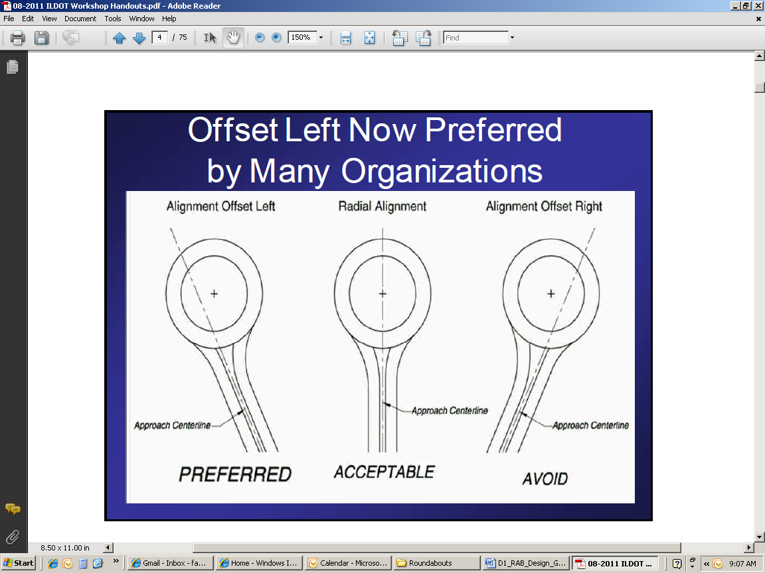
IDOT D1’s Perspective
Entry Deflection

Slide 28
IDOT D1’s Perspective
Entry Deflection continued

Slide 29
IDOT D1’s Perspective
Entry Deflection continued

Slide 30
IDOT D1’s Perspective
Possible Expandability
Sensitivity Analysis
  Existing Volumes To 20 Year Volumes
If Poor LOS / Queues
  Near Term (5-10 Years): 2-Lane RAB
  Long Term (10-20 Years): 1-Lane To 2-Lane
  Beyond 20-Years: 1-Lane (Consider 2-Lane)
If Expansion Is Needed
  Near Term: Expand Out To In
  Long Term: Expand In To Out

Slide 31
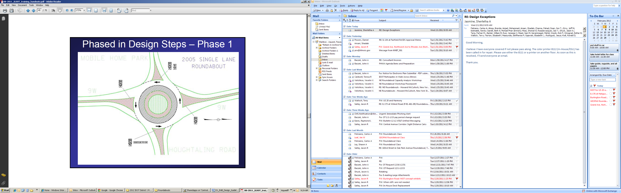
IDOT D1’s Perspective
Possible Expandability – Out to In

Slide 32
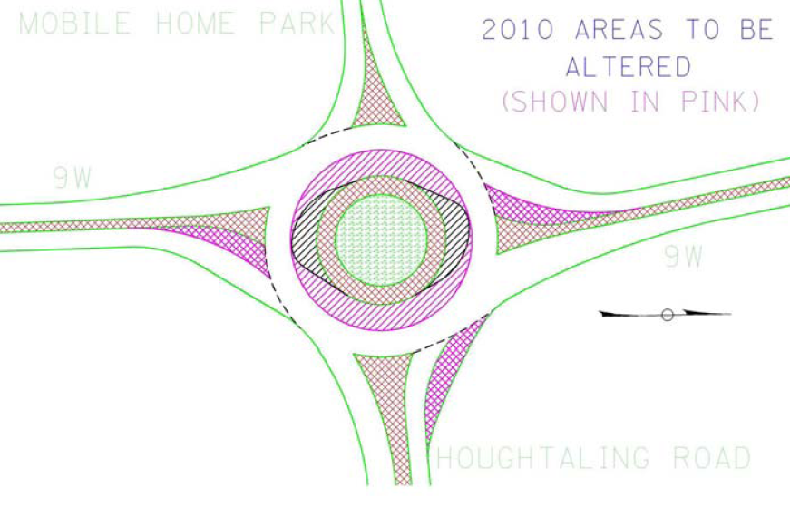
IDOT D1’s Perspective
Possible Expandability – Out to In

Slide 33
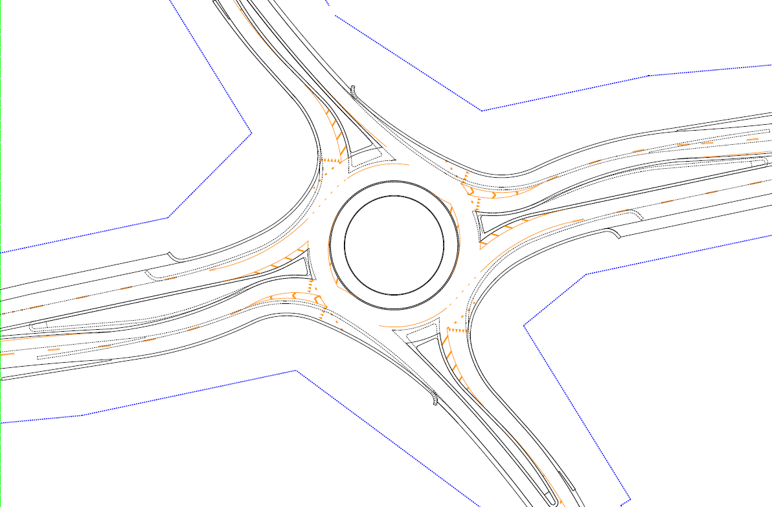
IDOT D1’s Perspective
Possible Expandability – In to Out

Slide 34
IDOT D1’s Perspective
Centerlines
Bureau Of Design & Construction Input
  Ease of Plan Preparation
  Ease of Contractor Layout
Bureau Of Programming Input
  Ease of Profile Layout
  Ease of Cross-Sections
  Based on Step-by-Step RAB Design

Slide 35
IDOT D1’s Perspective
Centerlines continued

Slide 36
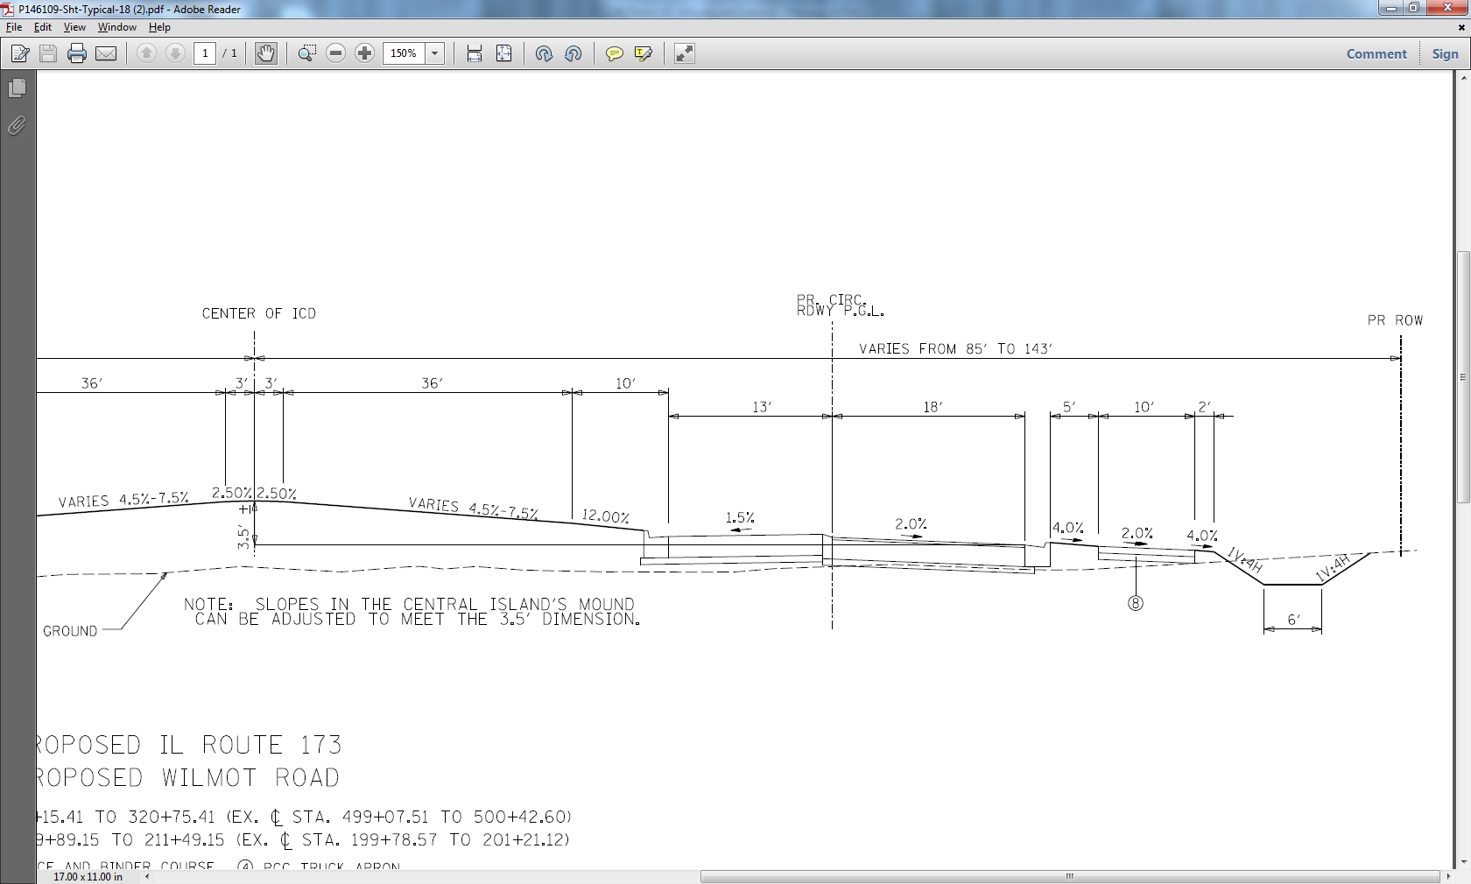
IDOT D1’s Perspective
Drainage
Circulating Roadway – OUT
Truck Apron – IN

Slide 37
IDOT D1’s Perspective
D1’s RAB Design Guidelines
  In Development
  Time Frame???

Slide 38
Conclusion
Roundabouts offer flexibility –
if you take advantage of it
Roundabouts can offer cost savings
Roundabouts require thoughtful design
Thank You For Coming! Any Questions?

